Slide 2
Objectives
Understand what is meant by an input device
Understand each of the following input devices and why they are required
Keyboard
Microphone
Optical mouse
Touch screen (resistive, capacitive and infra-red)

Slide 3


Starter
Think about the computer devices in the room you are in or a room in your home
What input devices do you use to interact with these devices?

Slide 4
Starter
Input devices transfer data form the source in the outside world to the computer
Examples include:
Keyboards
Mice
Digital cameras
Games controllers
Microphones

Slide 5
Computer systems
Computer systems work by:
Input devices putting data into the system
The data is processed
The processed data may then be saved using primary or secondary storage
Output devices send data from the computer to the user
Input devices
Processing
Output devices
Storage

Slide 6
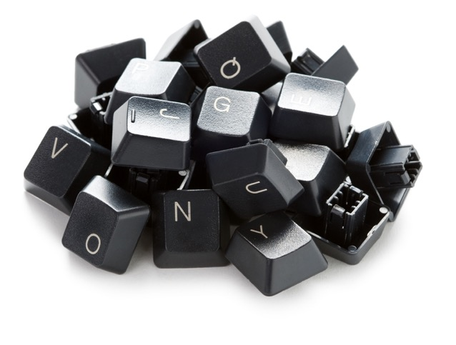
Keyboards
A key is made from plastic and has a small peg underneath which fits exactly into a hole in the keyboard when it is pressed
A small piece of rubber under the key makes it bounce back up so that it is ready to be pressed again

Slide 7
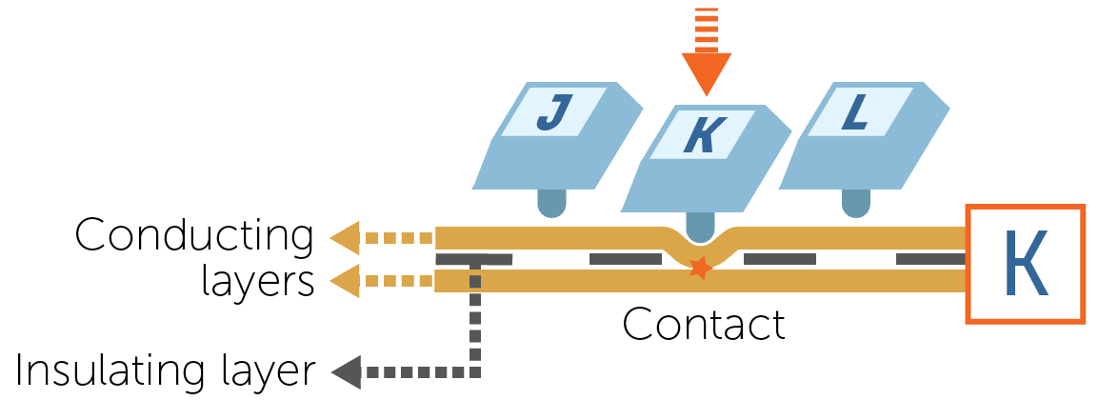
How a keyboard/keypad works
When a key is pressed, the small bar under the key pushes through a small hole and makes contact with a conducting membrane
Here, the letter K is pressed:

Slide 8
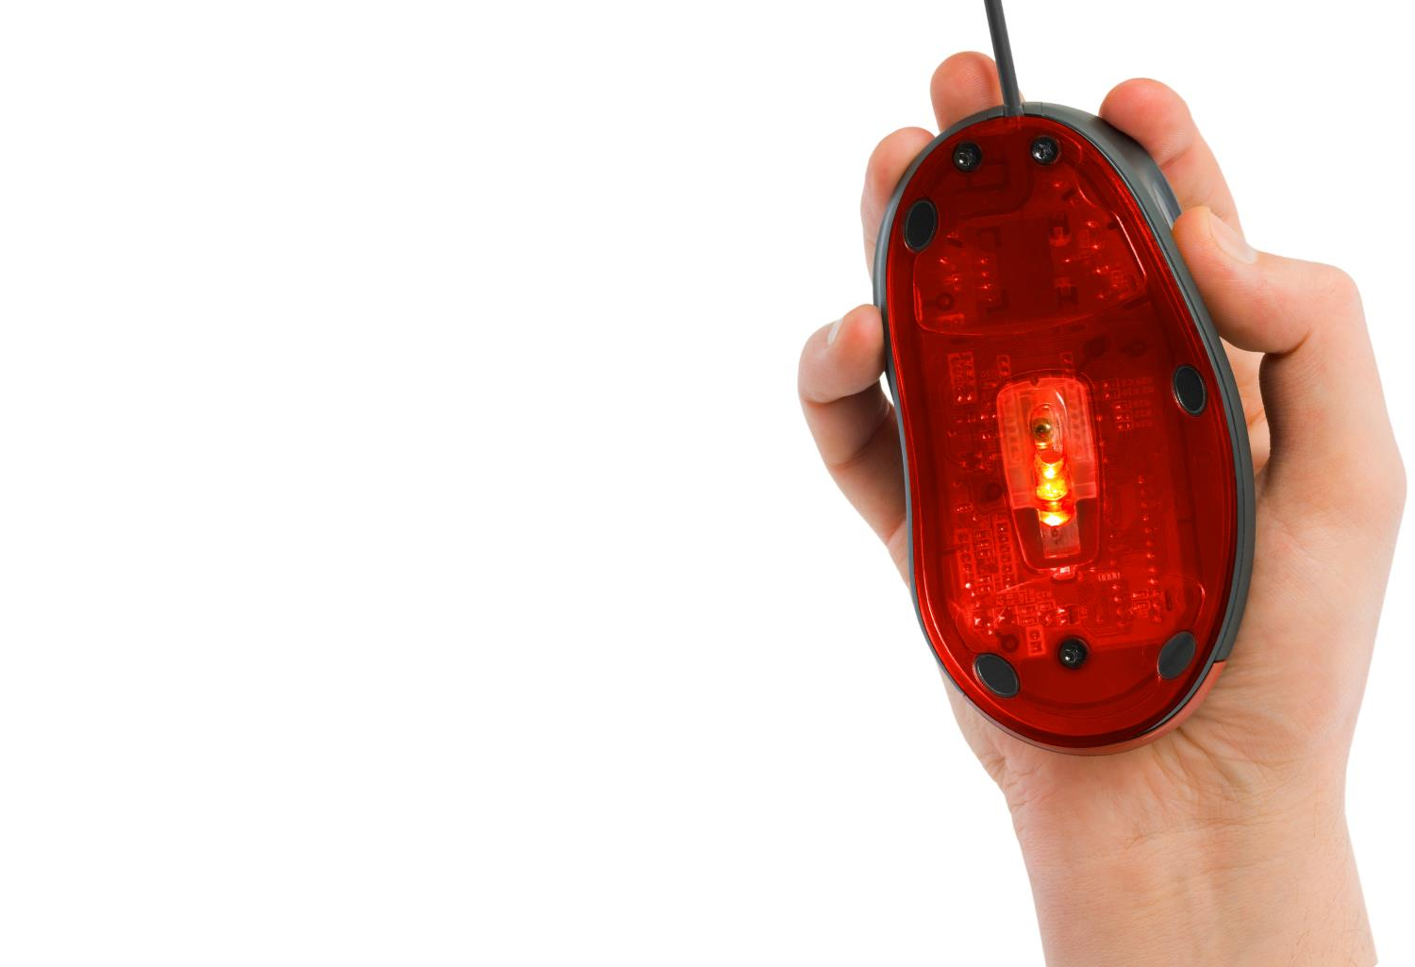
Optical mouse
A computer mouse is used for pointing and selecting areas on a display
An optical mouse shines light from a red LED onto a surface
A sensor takes repeated images of the surface and compare how these change when the mouse is moved

Slide 9
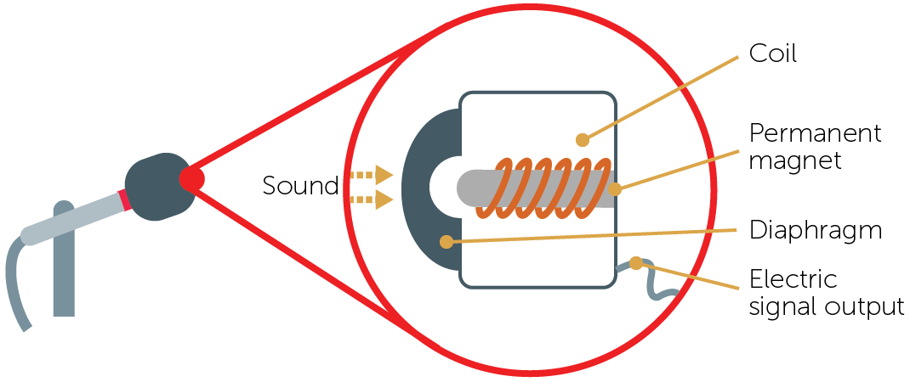
Microphones
When sound reaches the microphone, the diaphragm vibrates backwards and forwards
This causes the coil to vibrate which then changes the magnetic field produced by the magnet
Changes in current are detected and a signal is output

Slide 10
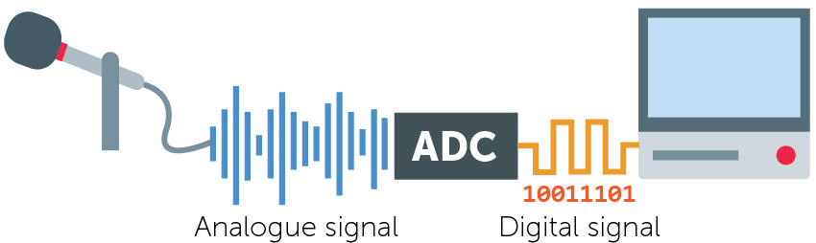
Analogue to digital conversion
The output from the microphone is analogue
This analogue signal needs to be converted into a digital signal so the computer can understand the data
An analogue to digital convertor (ADC) carries out the conversion

Slide 11
Microphones
Explain why microphones are required in the following situations:
Mobile phones
Tablet computers
A recording studio
A voice assistant such as Google Assistant or Alexa

Slide 12
Microphones
Mobile phones and tablet computers
For telephone calls, video calls, video recording, audio recording, virtual assistants
A recording studio
For recording voices and instruments – one microphone is used to record each track. These are then mixed together to form the final music recording
A voice assistant such as Google Assistant or Alexa
Microphones constantly are listening to hear if a key phrase is said – this makes the device listen to further instructions which are then detected by the microphone

Slide 13
Worksheet 1
Complete Task 1 on Worksheet 1

Slide 14
Touchscreens
Touchscreens act as both input and output devices
In this topic we will just consider the input component
The technologies used include
Resistive
Capacitive
Infra-red

Slide 15
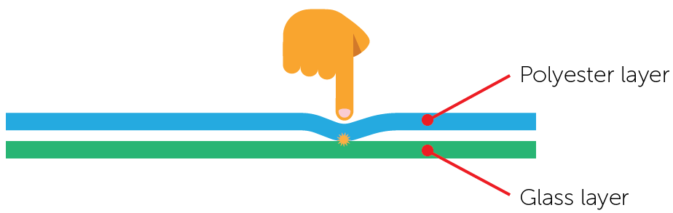
Resistive touchscreens
Resistive touchscreens are made up of a layer of conductive polyester and a layer of conductive glass
The two layers are separated by an insulating membrane
When the screen is gently pressed by a finger, the two conducting layers make contact and complete a circuit
The position where the screen is touched is calculated by a microprocessor

Slide 16
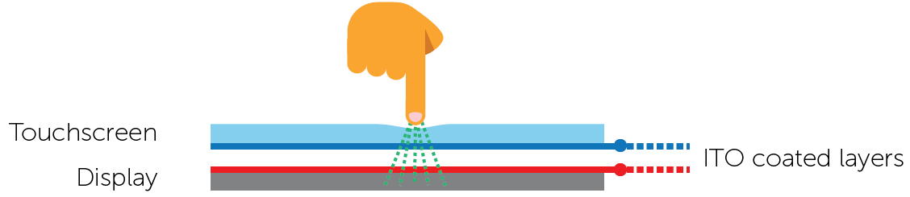
Capacitive touchscreens
Capacitive touchscreens are made up of glass layers
The bottom surface of the upper layer and top surface of the bottom layer are coated in perpendicular lines of transparent conductive material (Indium Tin Oxide) forming a grid
The screen behaves like a capacitor, storing electrical energy
The screen can be touched in more than one place at a time

Slide 17
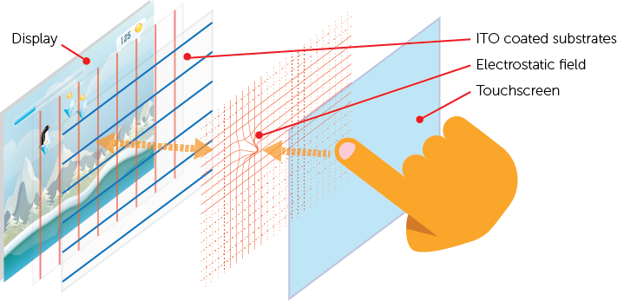
Detecting touch
When the screen is touched by a finger, there is a change in the electric field at that position
The position where the field changes is calculated by a microprocessor

Slide 18
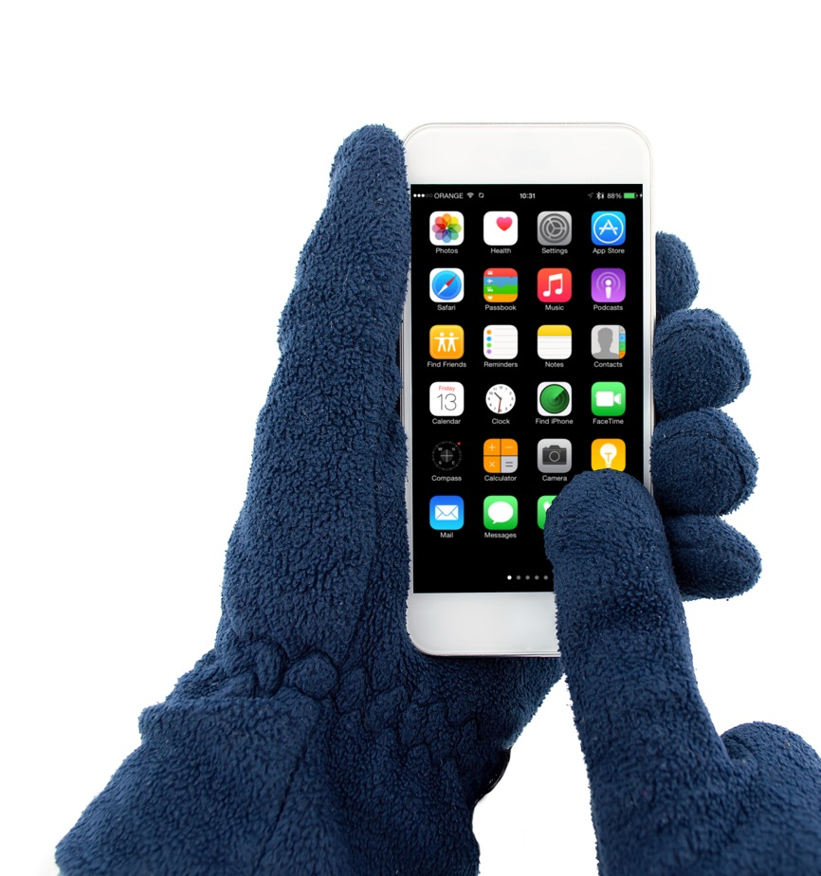
Capacitive touchscreens
Almost all touchscreen phones manufactured recently use a capacitive touchscreen
What are the advantages of using capacitive touchscreens?
What are the disadvantages of using capacitive touchscreens?

Slide 19


Capacitive touchscreens
What are the advantages of using capacitive touchscreens? Capacitive screen have a smooth surface They are very easy to press They are highly accurate
What are the disadvantages of using capacitive touchscreens? Capacitive screens don’t work if the user is wearing gloves

Slide 20
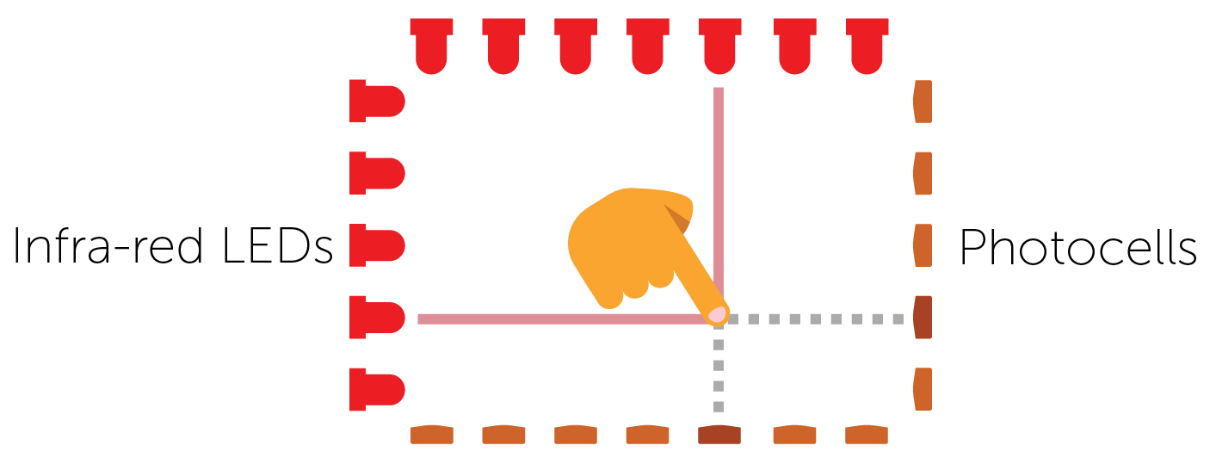
Infra-red touchscreens
LEDs shine infra-red light across the screen from the edges
The infra-red rays form a grid across the screen
When the screen is touched by a finger, the infra-red beam is interrupted
A microprocessor calculates the coordinates of where the screen was touched

Slide 21
Worksheet 1
Complete Task 2 on Worksheet 1

Slide 22
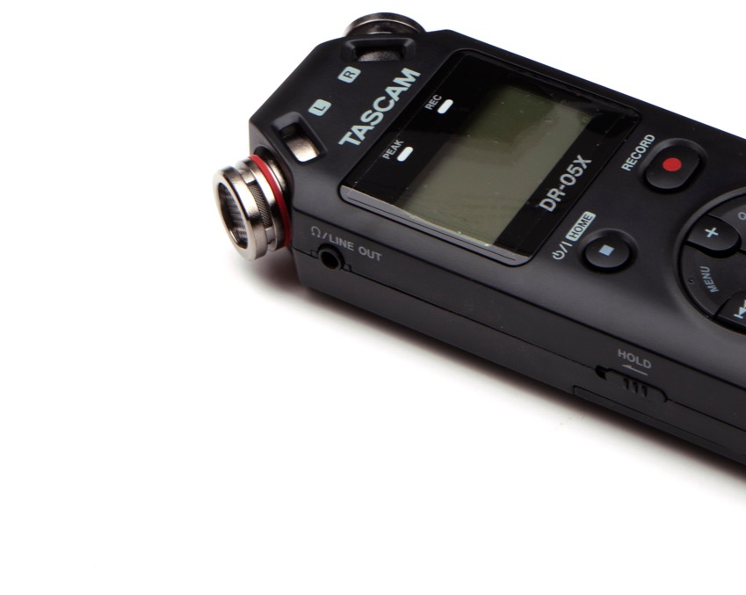
Plenary
Name input devices that are required for the following:
To write an essay
To select an icon on the desktop
To record a meeting
Choose a suitable touch screen technology for the following situations:
An interactive whiteboard
A tablet computer

Slide 23
Plenary
To write an essay - keyboard
To select an icon on the desktop - mouse
To record a meeting - microphone
Choose a suitable touch screen technology for the following situations:
An interactive whiteboard – resistive or infra-red
A tablet computer - capacitive

